Slide 1
HYPERTEXT MARKUP LANGUAGE
(HTML)

Slide 2
Key Objective
Get an idea about commonly used HTML tags
Learn the functions of different HTML tags and how to use them
Understand what attributes are and how they can change the appearance of tags
Handle table, frames, and images in a web page
Design and develop basic web page using HTML

Slide 3
HTML
Hypertext Markup Language is a set of tags and rules for using them in developing hypertext documents
Hyper is the opposite of linear. It used to be that computer programs had to move in a linear fashion
Text is what you will use. English letters, just like you use everyday
Markup is what you will do. You will write in plain English and then mark up what you wrote
Language. Some may argue that technically html is a code, but you write html in plain, everyday English language

Slide 4
Functions of HTML
Function of HTML also known as tags of HTML
<html> Defines an HTML document
<body> Defines the document's body
<h1> to <h6> Defines HTML headings

Slide 5
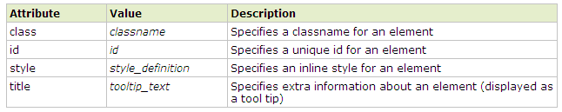
Attributes of HTML
Attributes provide additional information about HTML elements

Slide 6
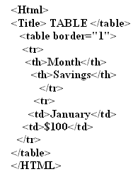
Table
The <table> tag defines an HTML table

Slide 7
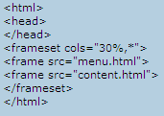
HTML Frames
HTML frames allow authors to present documents in multiple views, which may be independent windows or sub windows

Slide 8
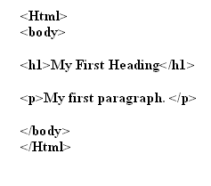
Design Sample Page of HTML

